Slide 1
LECTURE TWO – SAFETY AND MEDICAL DEVICES (PART ONE)
LAW2291_2024
Contemporary Issues in Biolaw (24/25)

Slide 2
0.0
Contents for today:
Safety Concepts
Medical Device Regulation Introduction

Slide 3
1.0 Safety
necessity
Background:
Financial interest, human interest
Safety engineering
Safety in industry
Safety as a concept!

Slide 4
Safety can be defined as:
Freedom from accidents or losses

Slide 5
1.1
Freedom from?
Literal – an absolute requirement
Accidents?

Slide 6
“An accident is an undesired and unplanned (but not necessarily unexpected) event that results in (at least) a specified level of loss.”

Slide 7
1.2
Accidents = non-adversarial failures
Losses?
Can be anything undesirable:
Damage – physical, financial, reputational
Outcome from failures
Failures?

Slide 8
“Failure is the nonperformance or inability of the system or component to perform its intended function for a specified time under specified environmental conditions.”

Slide 9
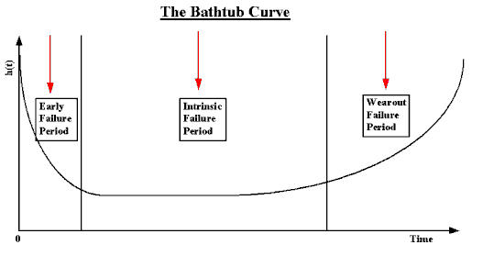
Source: https://itl.nist.gov/div898/handbook/apr/section1/apr124.htm
Not simple to use: https://ieeexplore.ieee.org/document/1179819

Slide 10
1.3
Error?
“An error is a design flaw or deviation from a desired or intended state.”

Slide 11
1.4
Hazard?
“A hazard is a state or set of conditions of a system (or an object) that, together with other conditions in the environment of the system (or object), will lead inevitably to an accident (loss event).”
Conversely, risk is simply the hazard level + likelihood of hazard leading to an accident, which must consider hazard exposure/duration.

Slide 12
1.5
Why is all of this relevant to medical devices and AI?
Cases:
A scalpel
A surgical robot
Any of the support for various scanning software (AI)

Slide 13
2.0 The Medical Device Regulation (MDR) (EU)
Medical devices
A continuation from the Medical Device Directive (MDD)
The MDD was a directive …
Not to be confused with the statutory instrument of 2002 No. 618 in British Law (does not apply to NI).

Slide 14
2.1 Structure
Similar to AIA
Chapter I Scope etc., Chapter II obligations/marking details, Chapter III identification/traceability of devices etc., Chapter IV Notified Bodies, Chapter V classification/conformity assessment, Chapter VI clinical evaluation/clinical investigations, Chapter VII post-market surveillance etc., Chapter VIII cooperation and coordination, Chapter IX confidentiality/data protection etc., Chapter X (final provisions)
More on everything next time!

Slide 15
2.1 Scope
Art 1(1)
This Regulation lays down rules concerning the placing on the market, making available on the market or putting into service of medical devices for human use and accessories for such devices in the Union. This Regulation also applies to clinical investigations concerning such medical devices and accessories conducted in the Union.
Art 1 is fairly detailed – exceptions are not relevant here, but worth taking a look at.

Slide 16
2.2
Applicability – to whom?
Area?
Accessories (we will come back to this in a moment)
For human use?
See SNITEM case, C-329/16, for more.

Slide 17
2.3
(1)
‘medical device’ means any instrument, apparatus, appliance, software, implant, reagent, material or other article intended by the manufacturer to be used, alone or in combination, for human beings for one or more of the following specific medical purposes:
diagnosis, prevention, monitoring, prediction, prognosis, treatment or alleviation of disease,
diagnosis, monitoring, treatment, alleviation of, or compensation for, an injury or disability,
investigation, replacement or modification of the anatomy or of a physiological or pathological process or state,
providing information by means of in vitro examination of specimens derived from the human body, including organ, blood and tissue donations,
and which does not achieve its principal intended action by pharmacological, immunological or metabolic means, in or on the human body, but which may be assisted in its function by such means.

Slide 18
The following products shall also be deemed to be medical devices:
Devices for the control or support of conception;
Products specifically intended for the cleaning, disinfection or sterilisation of devices as referred to in Article 1(4) and of those referred to in the first paragraph of this point

Slide 19
2.3 Accessories
Art 2(2)
‘accessory for a medical device’ means an article which, whilst not being itself a medical device, is intended by its manufacturer to be used together with one or several particular medical device(s) to specifically enable the medical device(s) to be used in accordance with its/their intended purpose(s) or to specifically and directly assist the medical functionality of the medical device(s) in terms of its/their intended purpose(s);

Slide 20
2.4
Accessories – but certification?
Recital 19
“Standard” software v custom-made
Next slide is an example of this problem for surgical robots.

Slide 21
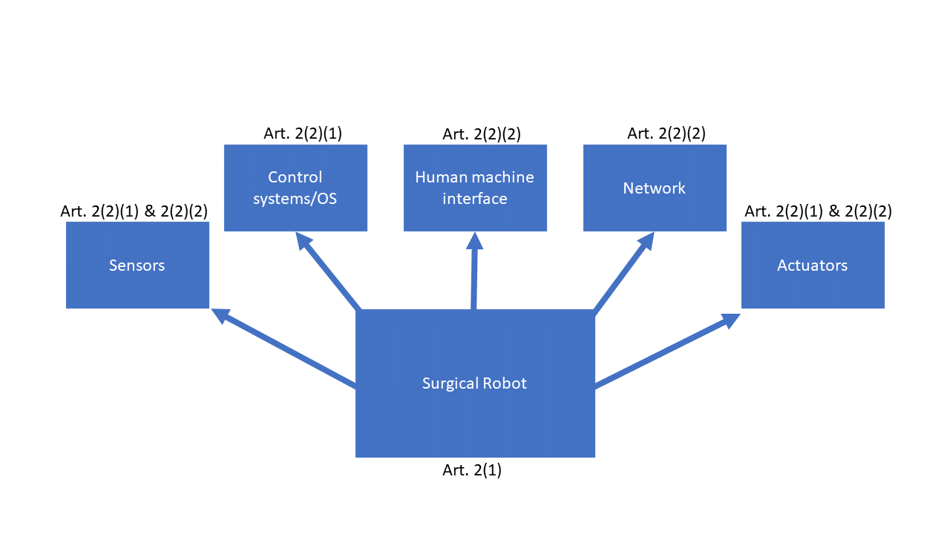

Slide 22
2.5 Other important definitions
‘manufacturer’ means a natural or legal person who manufactures or fully refurbishes a device or has a device designed, manufactured or fully refurbished, and markets that device under its name or trademark;
‘adverse event’ means any untoward medical occurrence, unintended disease or injury or any untoward clinical signs, including an abnormal laboratory finding, in subjects, users or other persons, in the context of a clinical investigation, whether or not related to the investigational device;

Slide 23
Questions – will not be recorded

